Slide 1

CALGARY CONSULTANCY
Navigate Your People Strategy To The New Normal

Slide 2
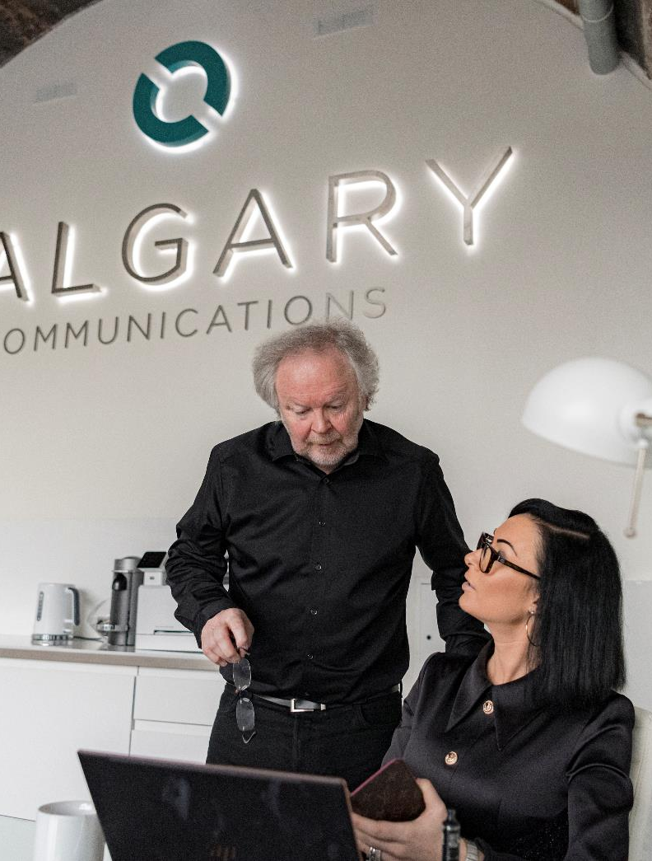
CALGARY CONSULTANCY
PEOPLE STRATEGY
GET THE INSIGHT YOU NEED TO DRIVE YOUR BUSINESS FORWARD.
Over the last few months everyone's priorities have changed
Yours
Your people’s
Your stakeholders
With fast policy patches and workarounds in place for now, you need solid data to work with to inform the new direction for your business
Calgary Consultancy has the answer, based around our ”proven not promised” evidence based approach.
.

Slide 3
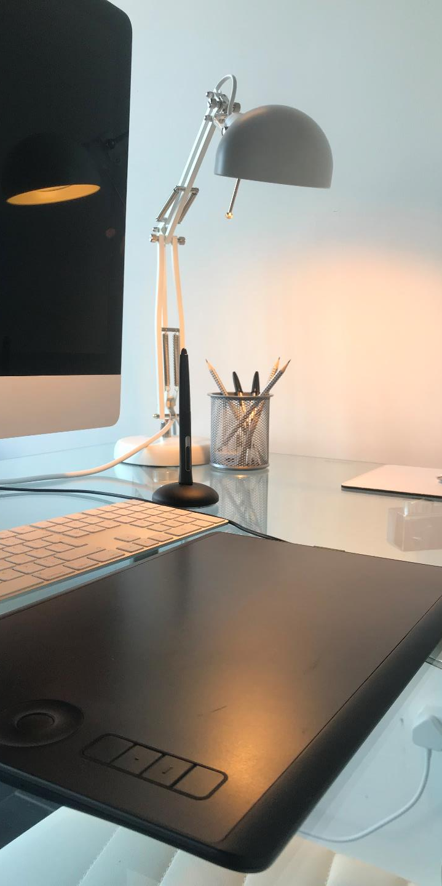
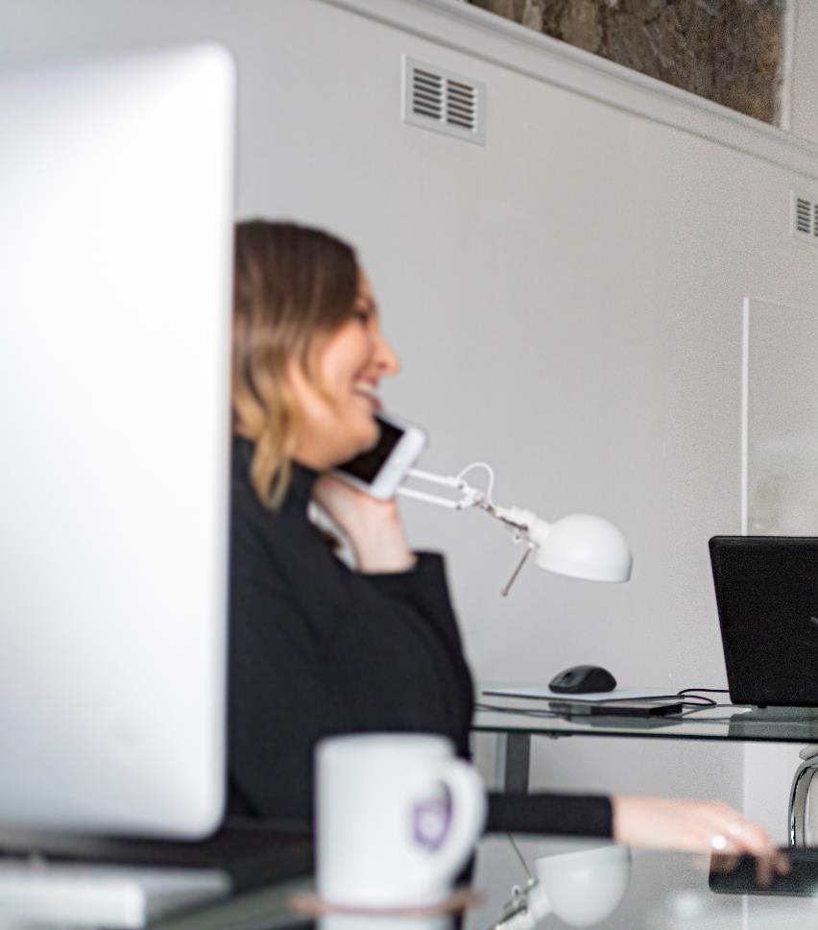
HOW IT WORKS
YOUR BESPOKE GAP ANALYSIS
PRE COVID
Our current state analysis benchmarks your objectives now against your pre-Covid plans to check that your projects and initiatives are still relevant - or if you need to rethink your priorities
.
CALGARY PROCESS – DEEP LISTENING
Our tried and tested Calgary research process and methodology begins with a deep listening exercise. This generates insight into your people’s perceptions and preferences, and what they would like to see from you now and in the future.
CALGARY PROCESS - ANALYSIS
We then analyse the results, map against your objectives and plans to identify synergies, gaps and potential new aspects to your people strategy around employee experience, culture and working environment
REPORT
We report on what we find and recommend areas for consideration based around good/best practice

Slide 4



EXAMPLE CONTEXT
SAFETY
ASSESS TIME SPENT
REMOTE WORKING
PART TIME
HOME OFFICE / SET UP
SECURITY
WORKING PATTERNS
INCLUSION
OFFICE
HOME ENVIRONMENT TECHNOLOGY
ENGAGEMENT
MOTIVATION
TEAMWORK
PERFORMANCE
VISIBILTY
REWARD
PERSONAL
POLICY
SECURITY
TECHNOLOGY
SICKNESS
ABSENCE
PERFORMANCE
REWARD
WORK/LIFE BALANCE
INCLUSION
OUTREACH
EMPLOYEE NETWORKS
ENVIRONMENTAL
COMMUNITY
REMOTE WORKING
SHIFT PATTERNS
WELL BEING
CYCLE TO WORK
INITIATIVES
THESE ARE WORKING EXAMPLES FROM OUR CLIENTS.
EVERY ORGANISATIONE IS DIFFERENT
BUT THERE ARE CORE ISSUES THAT CONNECT EVERY BUSINESS.

Slide 5
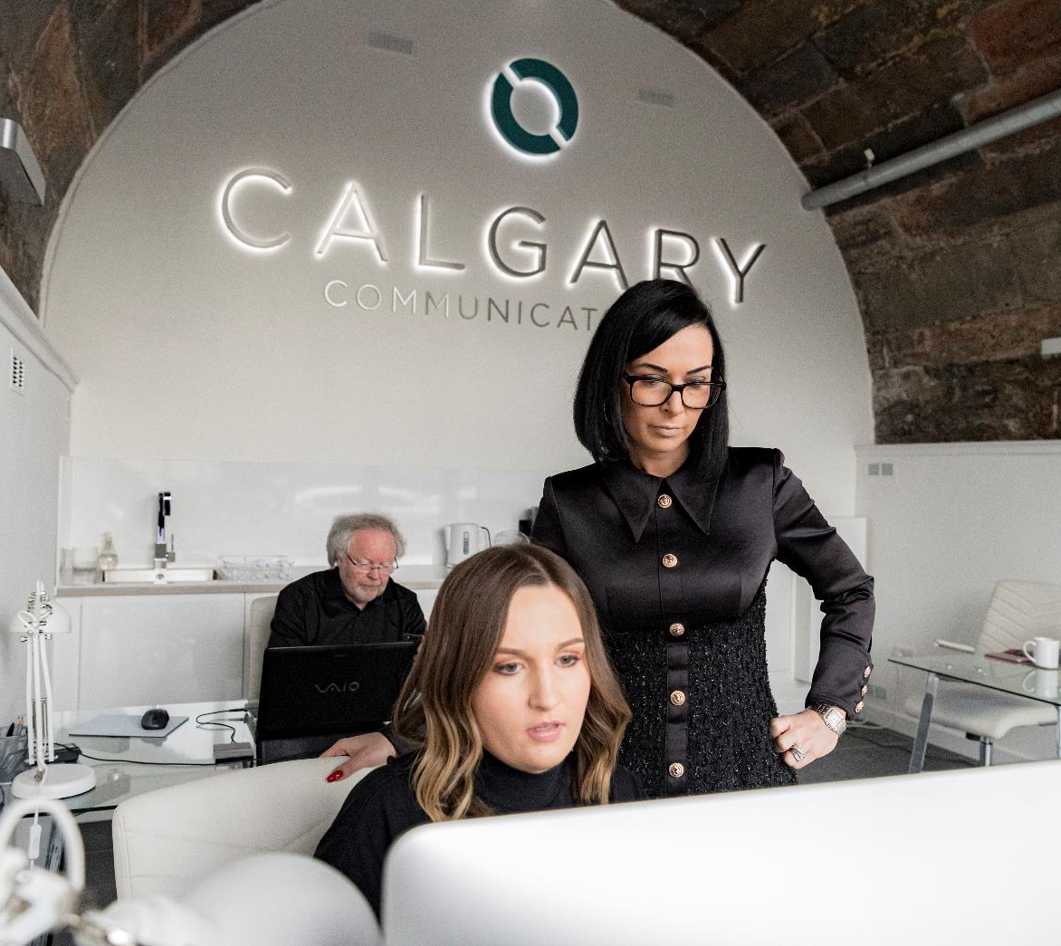
OUR PROCESS
CALGARY CONSULTANCY
Calgary are recognised experts in People Brand activity, including Employer Brand, EVP, employee and candidate experience, mapping culture and behaviours, and creating talent attraction strategies that deliver.
Our process has been developed by us over the last 10 years, working for global, national and local businesses and sectors from engineering to exploration, finance to manufacturing, and technology to professional services.
It is a unique robust, evidence-based process that gathers and reflects themes, trends and direction, and that has helped to guide many organisations in their people strategy.

Slide 6





RESEARCH
CALGARY CONSULTANCY
1
2
DEEP LISTENING
EVIDENCE
Our in depth research is based around the areas where you need to have actionable and dependable data, and where deep listening will unearth honest and open opinions and attitudes.
All work is recorded, transcribed reviewed and analysed using our unique discovery matrix to create the evidence-based result that is our hallmark.
3
4
METHODOLOGY
AGILE
Our research uses several tried and tested methodologies with over 60 years joint Director experience within this field.
.
We have adapted our process to work in both virtual and face to face situations.

Slide 7

OUTPUTS
CALGARY CONSULTANCY
In depth listening to your people
Message matrix and themes
Overview and benchmark of the research and results
Clear reports on the areas you need to know about
Dependable, quantifiable data
Gap analysis
Recommendations/good practice
Actions you may want to consider

Slide 8
TESTIMONIALS
CALGARY CONSULTANCY
I have worked with Steve and Jennifer from Calgary Communications for several years, in a range of organisations across a number of sectors. One of the unique aspects is the amount of time that they invest to truly understand the company, the objective of the project and the dynamics of the team. Their expertise in all aspects of people related communications is deep rooted, add to that they always bring innovative and creative solutions, mindful of the messaging whilst not losing sight of the budget challenges. They are generous with their extensive network and are always on hand to give advice and support. I have and will continue to recommend them to both individuals and organisations as well as looking forward to working with them again myself.
I have had the pleasure of partnering with Jennifer and Steve for over 10 years, across a number of different organisations/sectors. Calgary Communications not only bring their specialist EVP knowledge, but also their wealth of knowledge across a range of People workstreams – employee lifecycle, culture and behaviours, employee engagement, onboarding and resourcing. Calgary Communications are always generous with their time and their network, and have connected me to many specialists who have supported me in delivering the very best for my organisations. Calgary Communications are not afraid to challenge opinions at Board level to reach the optimum outcome. I trust Jennifer and Steve to do the right thing - and would partner with them again without hesitation.
SHONA MCKENZIE,
FERGUSON & MCKENZIE.
CAROLE LAMOND,
BUZZWORKS HOLDINGS.

Slide 9
COST MODEL
CALGARY CONSULTANCY
ESSENTIAL
ESSENTIAL +
COMPLETE
£10,000
£15,000
£20,000
PROJECT COST
PROJECT COST
PROJECT COST
Current State Assessment
Current State Assessment
Current State Assessment
Deep Listening
Deep Listening
Deep Listening
Analysis
Analysis
Analysis
Report
Message Matrix / Themes
Message Matrix / Themes
Report
Benchmark / Gap Analysis / Good Practice / Recommendation & Report
Delivery Time
4 Weeks Approx
Delivery Time
6 Weeks Approx
Delivery Time
8 Weeks Appox

Slide 10
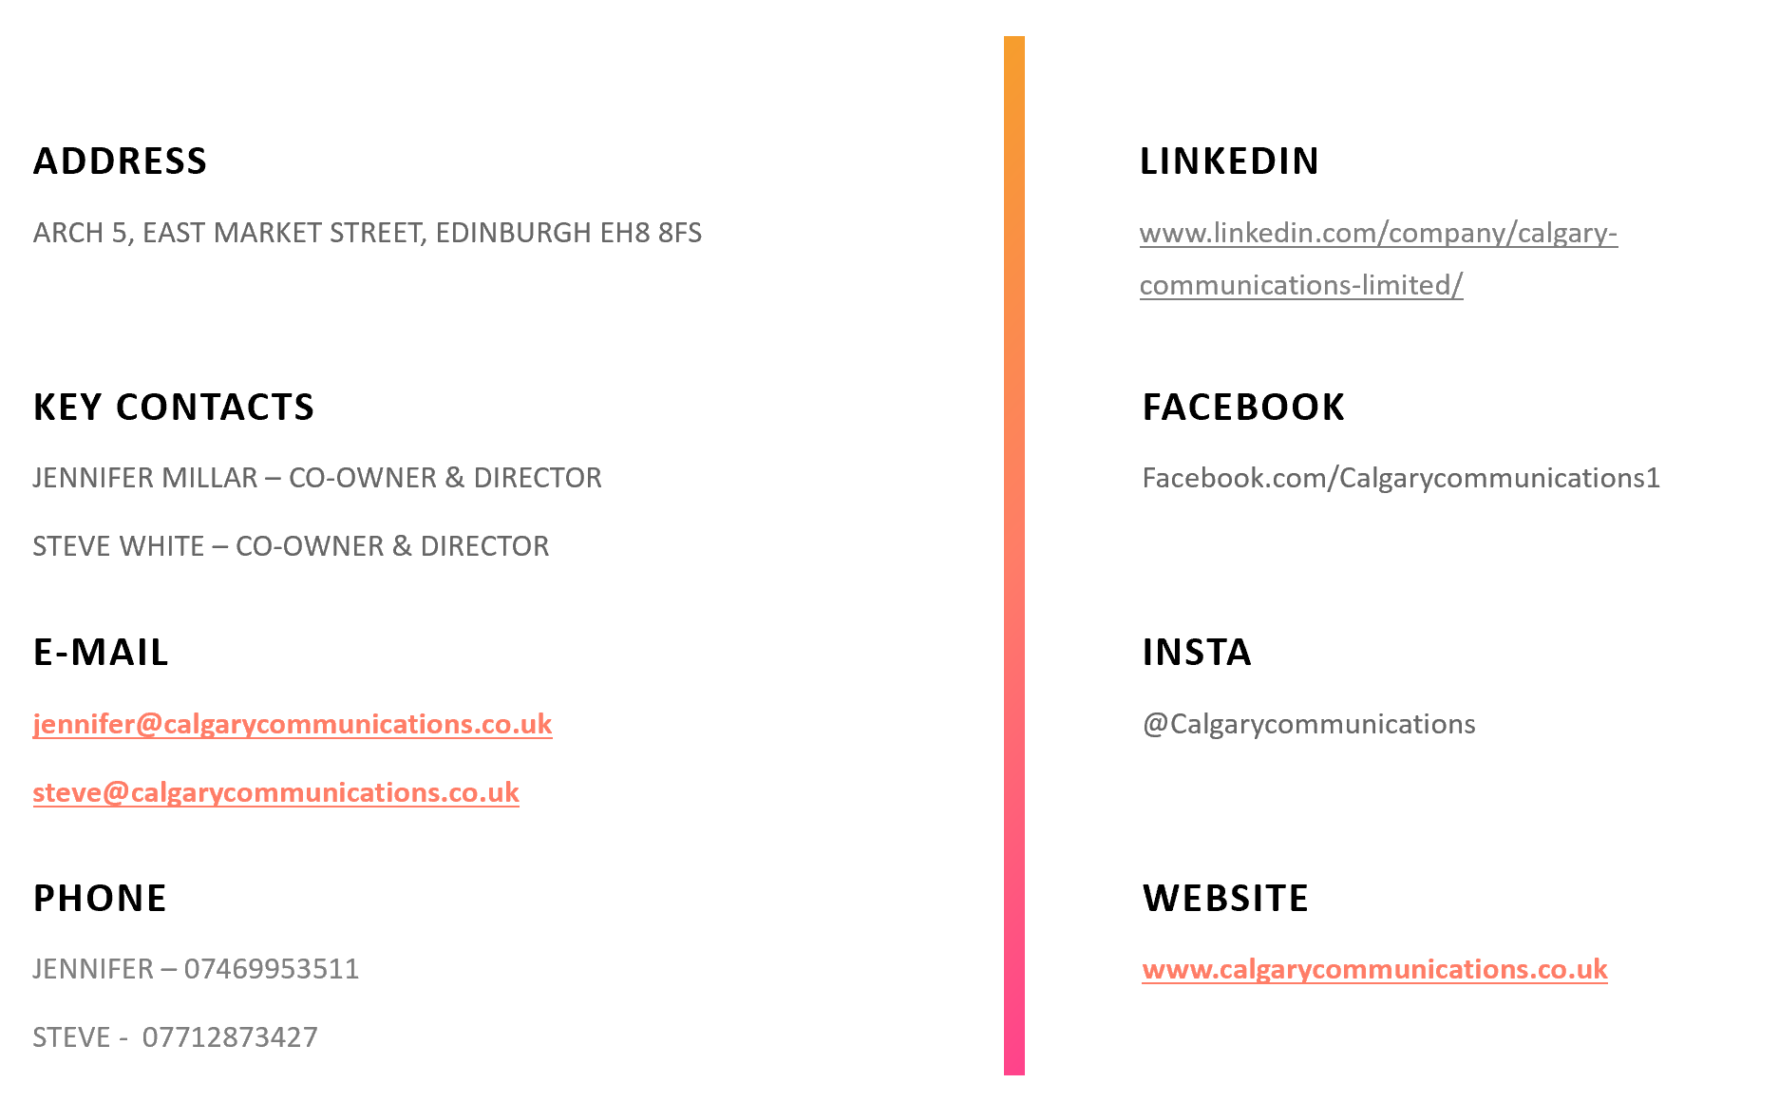
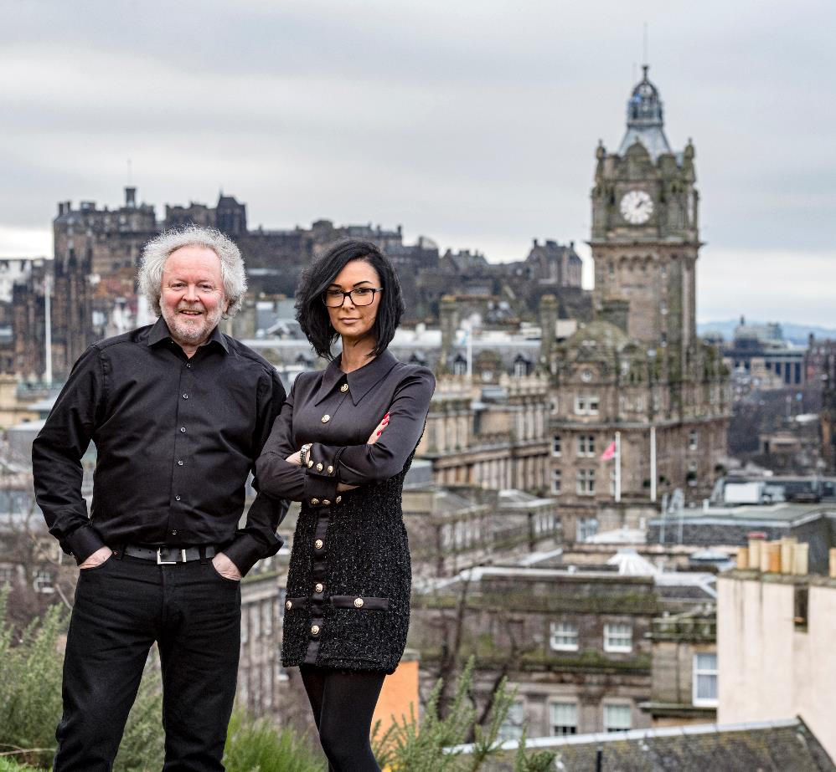
CONTACT US
www.calgarycommunications.co.uk

Slide 11
CALGARY CONSULTANCY
Navigating Your People Strategy To The New Normal

